Slide 1
Kafka Backup
Guido Schmutz (guido.schmutz@trivadis.com)
gschmutz
http://guidoschmutz.wordpress.com

Slide 2
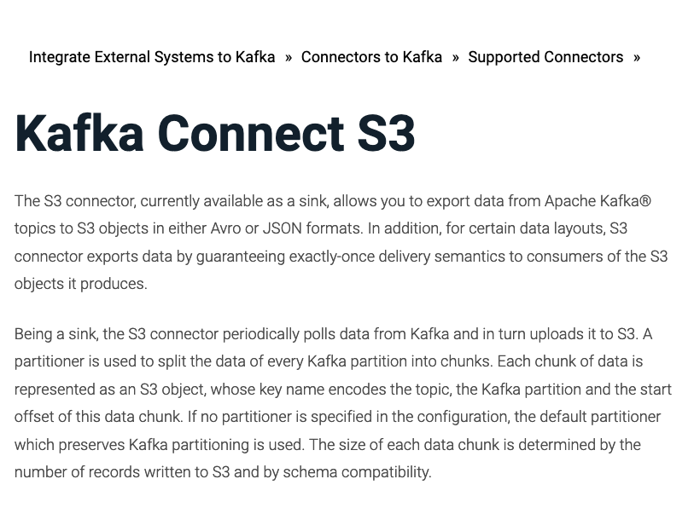
Confluent Kafka Connect S3
https://docs.confluent.io/current/connect/kafka-connect-s3/index.html

Slide 3
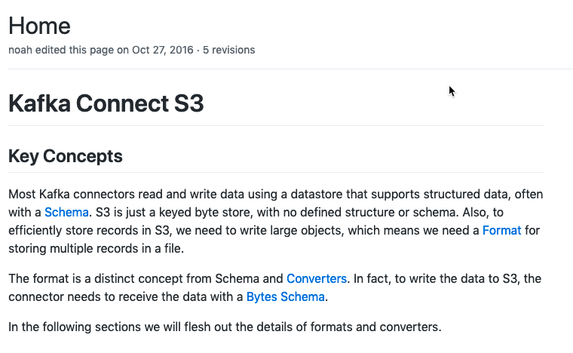
Spreadfast S3
https://github.com/spredfast/kafka-connect-s3
https://github.com/spredfast/kafka-connect-s3/wiki

Slide 4
Comparison
Confluent S3
Only Sink Connector
Exactly Once Delivery
Pluggable Partitioner
Partition Based (default)
TimeBased
ByteArrayFormat for binary
Spredfast S3
Source and Sink Connector
Text Format, Binary Format or Custom Format
Gzip Output

Slide 5
Confluent

Slide 6
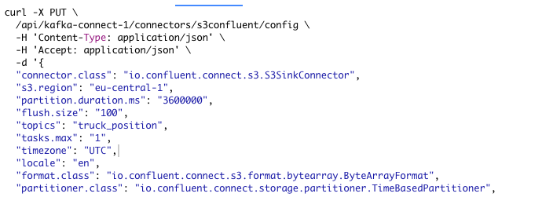

Slide 7
Spreadfast

Slide 8
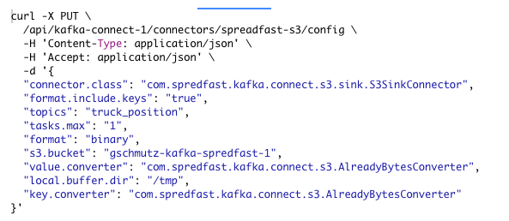

Slide 9
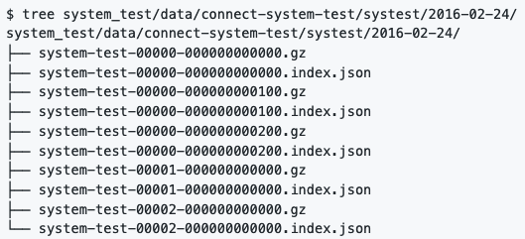
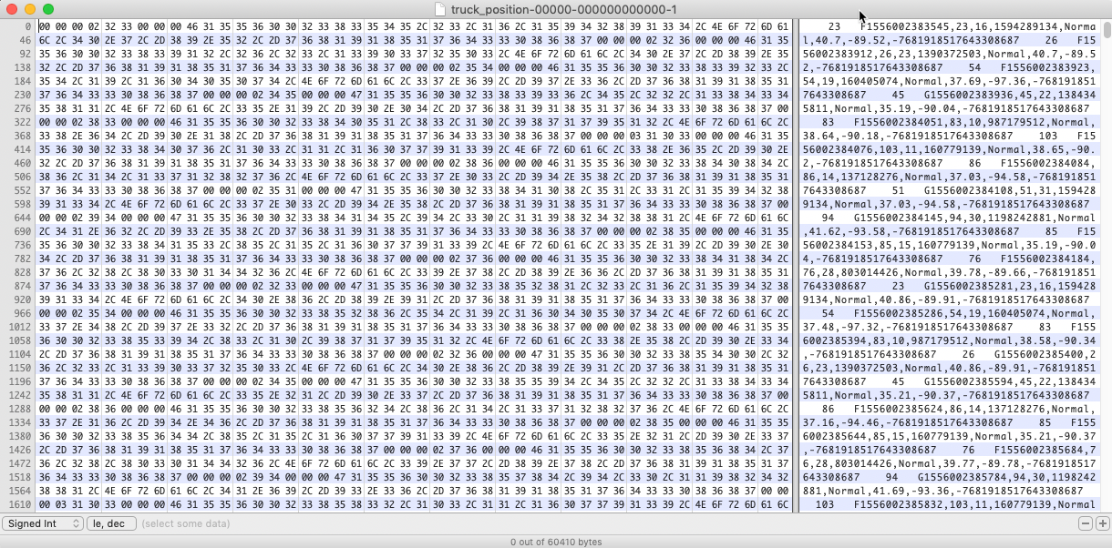
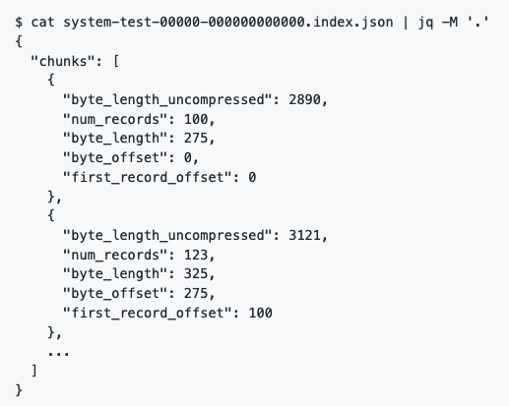
Spredfast Binary Format

Slide 10
Technology on its own won't help you.
You need to know how to use it properly.

